Slide 1
Reverse-Engineering of the EGFR Signaling Pathway to understand Biochemical Basis of Modularity
January 6, 2025
H Steven Wiley

Slide 2
Overall goals of our work
Build models of signaling pathways important in cancer cell physiology that can predict the impact of copy number variation (CNV) and drug treatment
These models must predict how molecular-level alterations propagates up to the physiological level, and thus need to be both mechanistic and scalable
Ideally, there should be one general model that can modified using molecular measurements to instantiate a model of any specific cancer cell type
The models need to be computationally tractable
Because of these considerations, we are developing a scalable “coarse grain” modeling framework that can predict cell behavior from high-throughput data sources

Slide 3
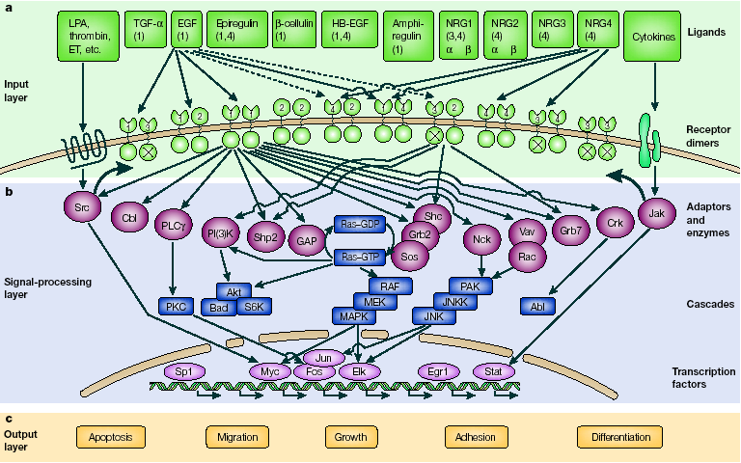
Epidermal Growth Factor Receptor System
Yarden, Eur. J. Canc. [2001]

Slide 4
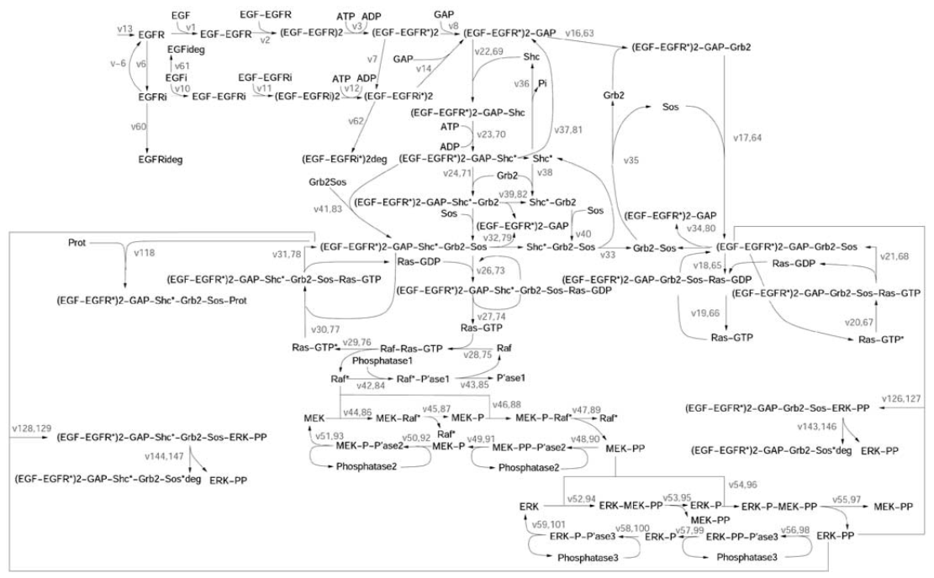
Bottom-up kinetic models are difficult to parameterize and not scalable
Hornberg, J.J., Binder, B., Bruggeman, F.J., Schoeberl, B., Heinrich, R., and Westerhoff, H.V. (2005). Oncogene 24, 5533–5542.

Slide 5
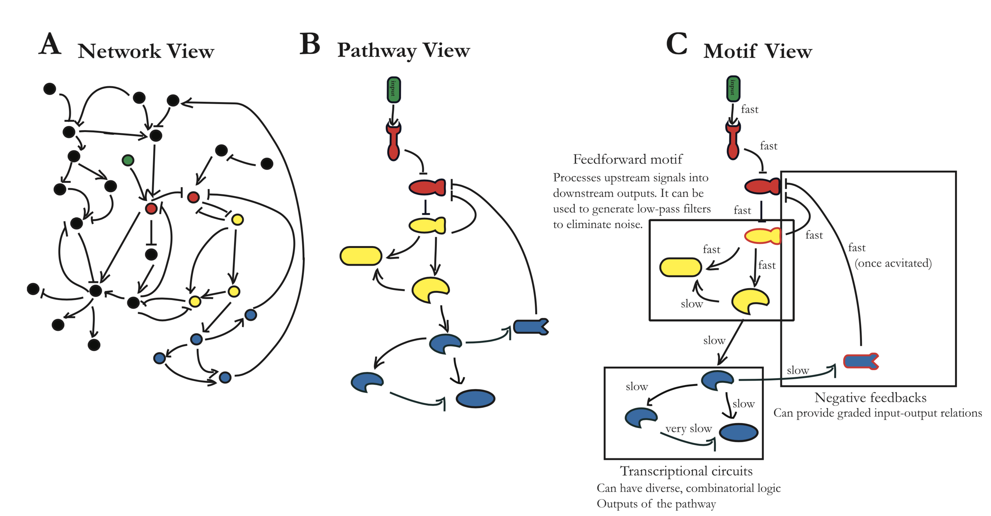
How do you break down the system into a useful level of abstraction for modeling?
Atay, Oguzhan & Skotheim, (2014) Modularity and predictability in cell signaling and decision making. Mol Bio Cell. 25:3445-50

Slide 6




“Object oriented” modular approach to modeling
Break down complex pathways in to evolutionarily conserved “modules”
Use system-theoretic approaches to quantify:
Input-output relationships of individual modules
Module connectivity (feedback loops)
Detailed mechanistic models for individual modules
Since we are dealing with smaller portions of the overall network, mechanistic modeling becomes computationally tractable
Parameterized modules should be reusable across different cell types

Slide 7
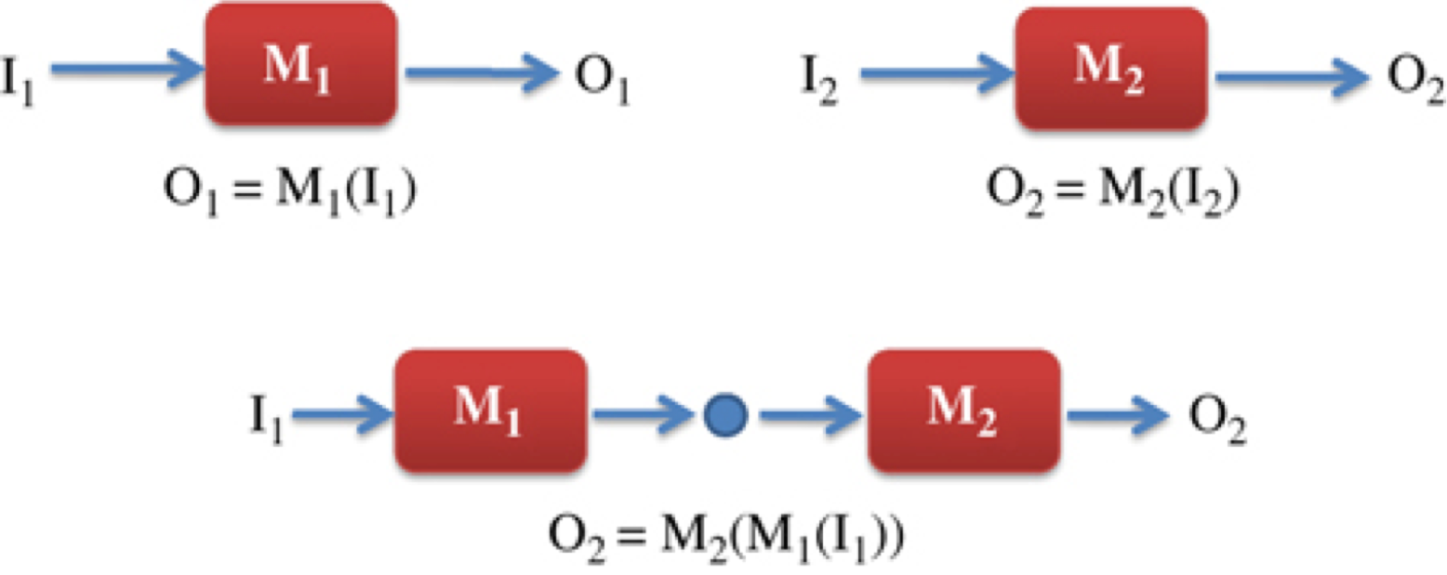
Module Definition
Definition of a module: two biochemical systems, M1 and M2, have defined input and output characteristics where we are able to predict the behavior of the composite network M2(M1) from the input/output characteristics of the individual systems. The ability to predict the behavior of M2(M1) requires minimal retroactivity between M1 and M2.

Slide 8
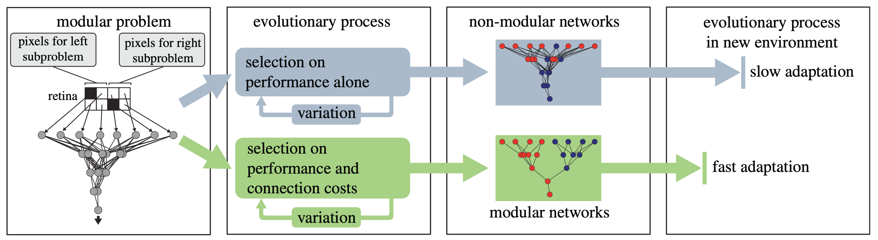
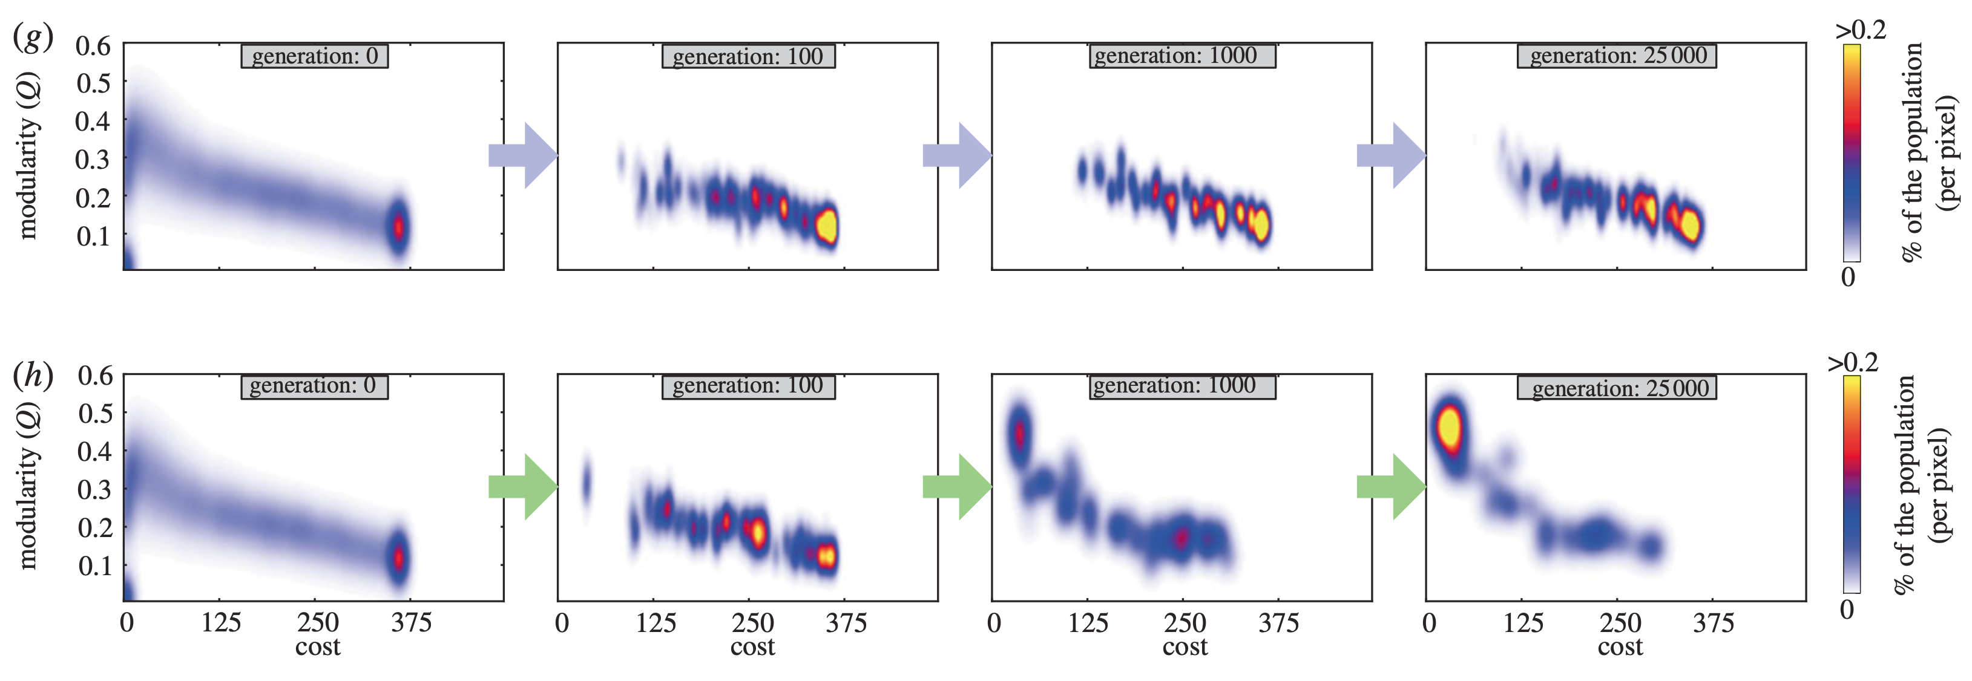
Modularity is thought to arise during evolution to minimize thermodynamic cost of connections
Performance alone
Performance plus Connection Costs
Clune J, Mouret J-B, Lipson H. 2013 The evolutionary origins of modularity. Proc R Soc B 280: 20122863.
Notes:
If the concept of module was just a conceptual framework, it would not be very useful. Fortunately, it is deeply rooted in evolutionary biology. Biological systems have evolved to be modular. Some simulation studies have explored why, and it seems to be due to reduction of thermodynamic costs and evolvability.

Slide 9
Module Definition – evolutionary driven
Isolation
Biochemical processes that link the input to the output must be effectively insulated from upstream and downstream processes (low retroactivity)
Reusability
The set of proteins comprising the module must display evidence of being used in different cellular contexts and pathways.
Regulation
The input-output relationship should show evidence of being actively regulated by extra-module processes
Function
The module should have the same function across multiple cell contexts

Slide 10
The EGFR signaling pathway shows obvious signs of modularity
The human EGFR retains all measurable functions when expressed in Xenopus oocytes
Activation of the MAPK pathway
Accelerated endocytosis upon activation
Polarized trafficking
Regulation of calcium flux
Multiple components are used in other signaling pathways
GAB1-SHP2
GRB2-SOS
MAPK cascade

Slide 11
Identification of biochemical processes that confer low ‘retroactivity’
These boundaries can be identified within pathways by kinetic, biochemical and protein-interaction experiments
Notes:
One of the things we are doing is to identify the modular structure of biological networks by their biophysical properties. This provides an experimental approach to reduce the complexity of biological networks.

Slide 12
We used phosphoproteomics to identify dynamic flow of information through the EGFR network
The EGFR pathway is kinase-driven and thus changes in protein phosphorylation should reflect information flow
Use ELISA and imaging assays to measure non-phosphorylated nodes (e.g., RAS activation).
Precisely define relationship between EGF dose, treatment time and downstream signaling events
Integrate the proteomics data with previous data on protein characteristics and functions
Identify important signaling nodes and their relationships

Slide 13
Experimental design and data analysis workflow

Slide 14
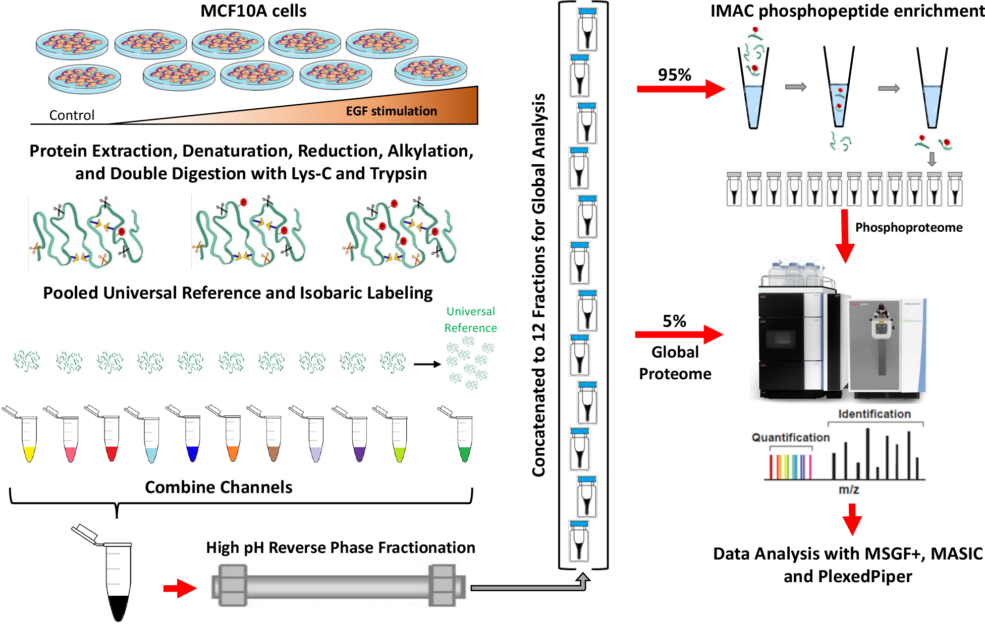
Proteomics-phosphoproteomics workflow

Slide 15
General results
Detected 9468 proteins of which 8148 could be quantified
Identified 42,314 phosphorylation sites from 6353 proteins
35,629 were on serine, 6,294 were on threonine and 1,892 were on tyrosine residues
Total of 4,126 sites showed at least a 2-fold change in intensity in at least one experiment
184 sites showed at least a 2-fold change in intensity in all samples
Approximately 60-90% of the changes in phosphorylation were downstream of MAPK/ERK

Slide 16
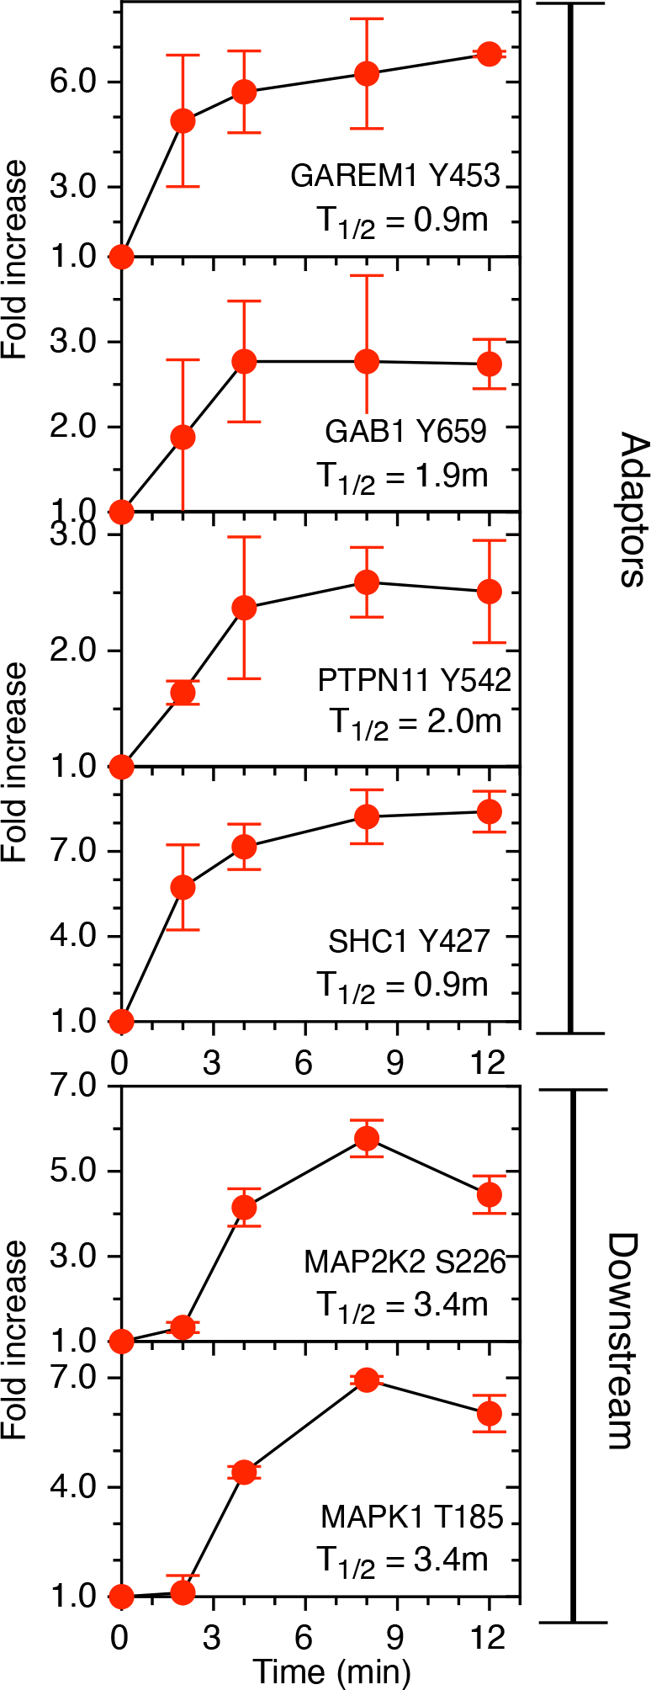
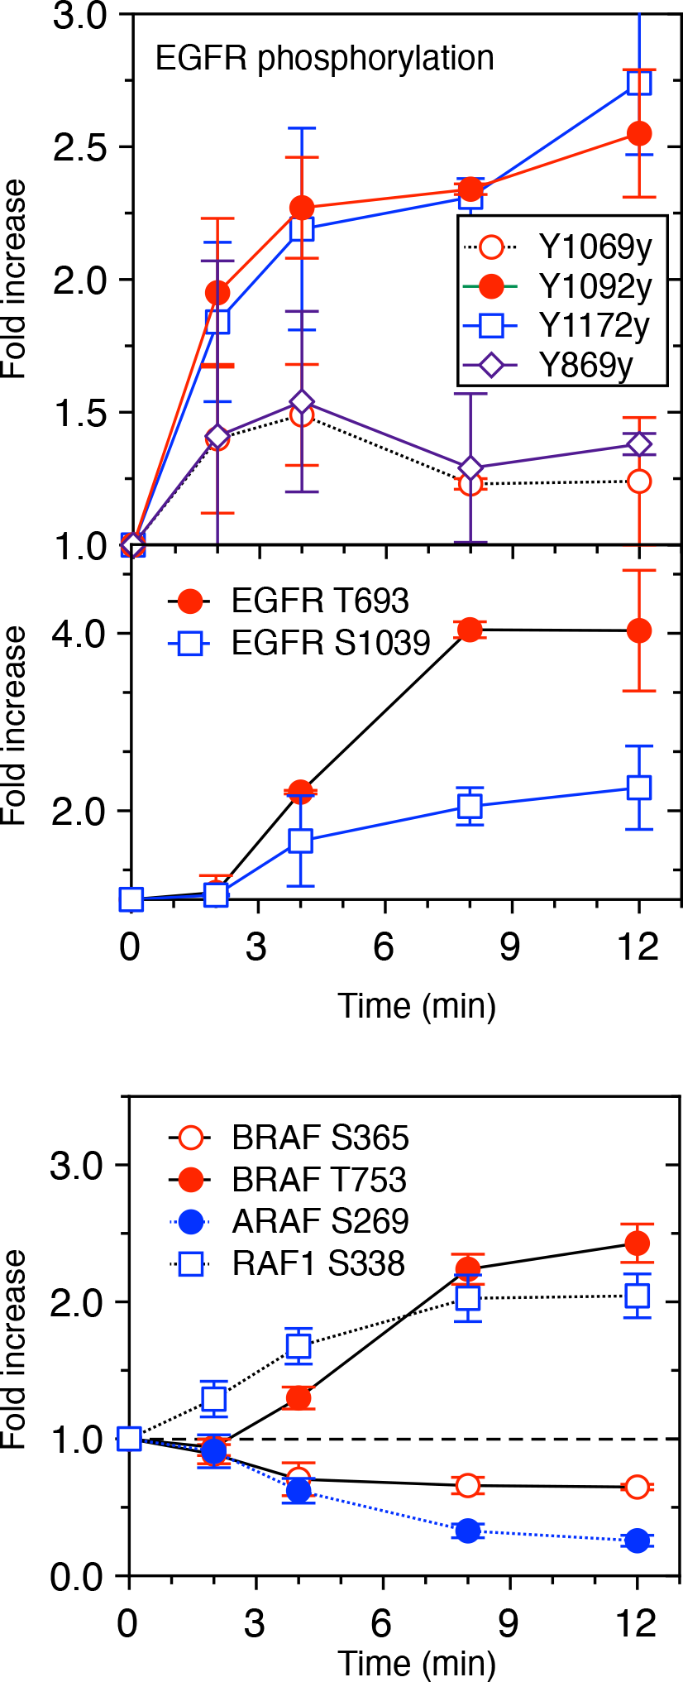
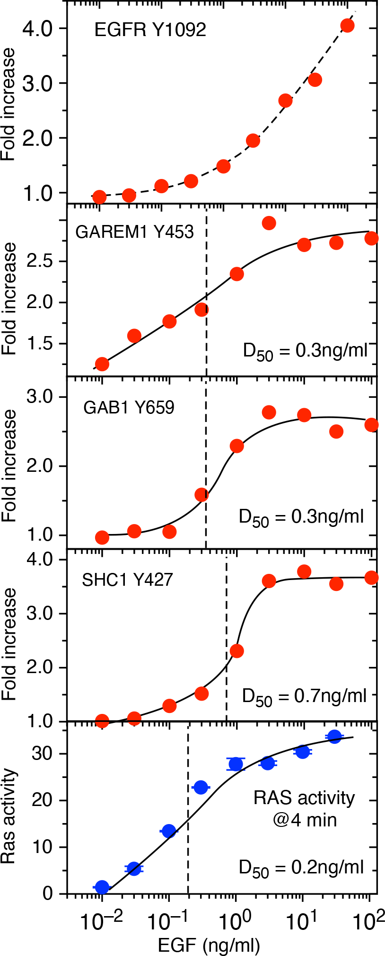
Activation of the EGFR pathway by phosphoryation
Song et al., BioRxiv (2023) A Phosphoproteomics Data Resource for Systems-level Modeling of Kinase Signaling Networks

Slide 17
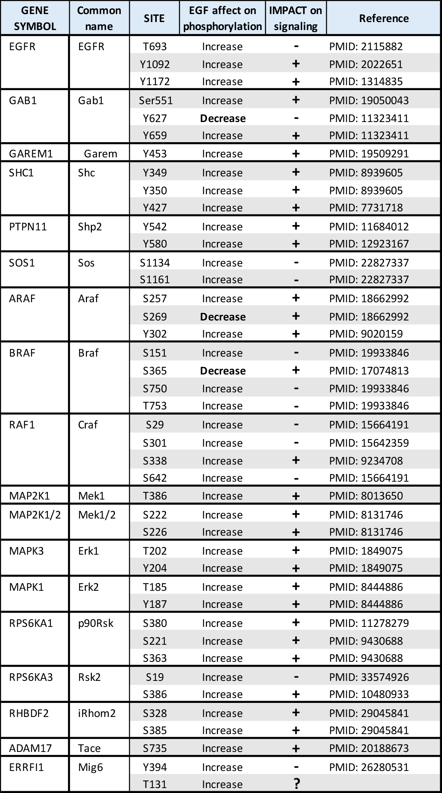
Mapping positive and negative phosphorylation events

Slide 18
Parsing the EGFR pathway into modules

Slide 19
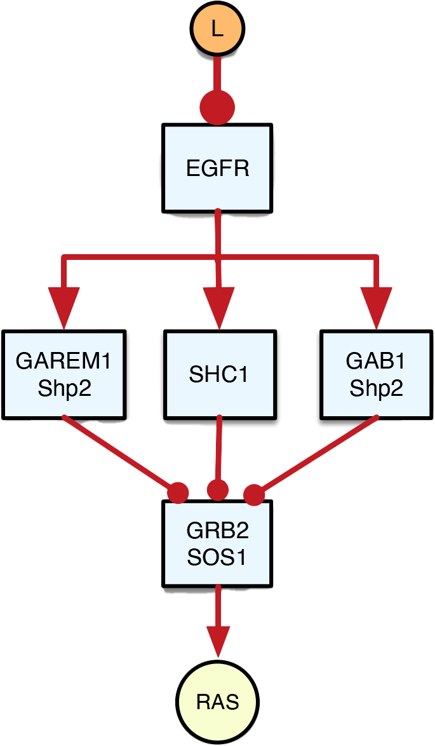
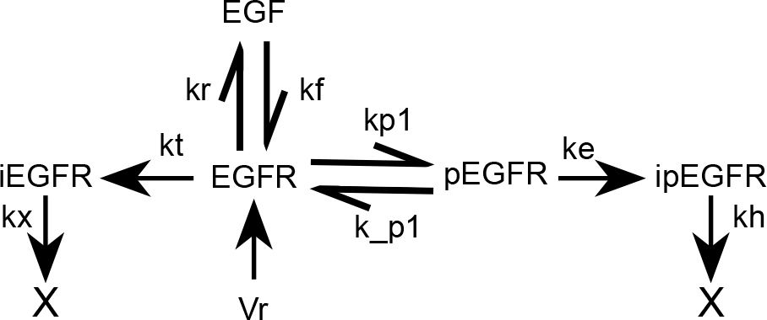
Modules are basis of kinetic reactions

Slide 20
Modules between EGF binding and Ras activation

Slide 21
Site-level module specifications
EGF Receptor
Shc1
Grb2-Sos1
Garem1
Gab1

Slide 22
Modular framework facilitates building complex, predictive models

Slide 23
Differences between cell types can be traced to both qualitative and quantitative module differences
MCF10A
HS578T
Notes:
This was established after extensive proteomics analysis and perturbation studies. We conclude that in many cases, different behaviors of cancer cells is due to 1) mutation in specific proteins, 2) amplification of specific modules, 3) loss of regulatory modules.

Slide 24
Module Definition – evolutionary driven
Isolation
Biochemical processes that link the input to the output must be effectively insulated from upstream and downstream processes (low retroactivity)
Reusability
The set of proteins comprising the module must display evidence of being used in different cellular contexts and pathways.
Regulation
The input-output relationship should show evidence of being actively regulated by extra-module processes
Function
The module should have the same function across multiple cell contexts

Slide 25

We use the concept of ‘design patterns” to define evolutionarily conserved function of modules

Slide 26




Acknowledgements
Michael Kochen²
Song Feng¹
James A. Sanford¹
Thomas Weber¹
Chelsea M. Hutchinson-Bunch¹
Panshak P. Dakup¹
Vanessa L. Paurus¹
Kwame Attah¹
Steven Andrews²
Herbert Sauro²
Wei-Jun Qian¹
¹Biological Sciences Division, Pacific Northwest National Laboratory
²Department of Bioengineering, University of Washington

Slide 27
Questions?

Slide 28
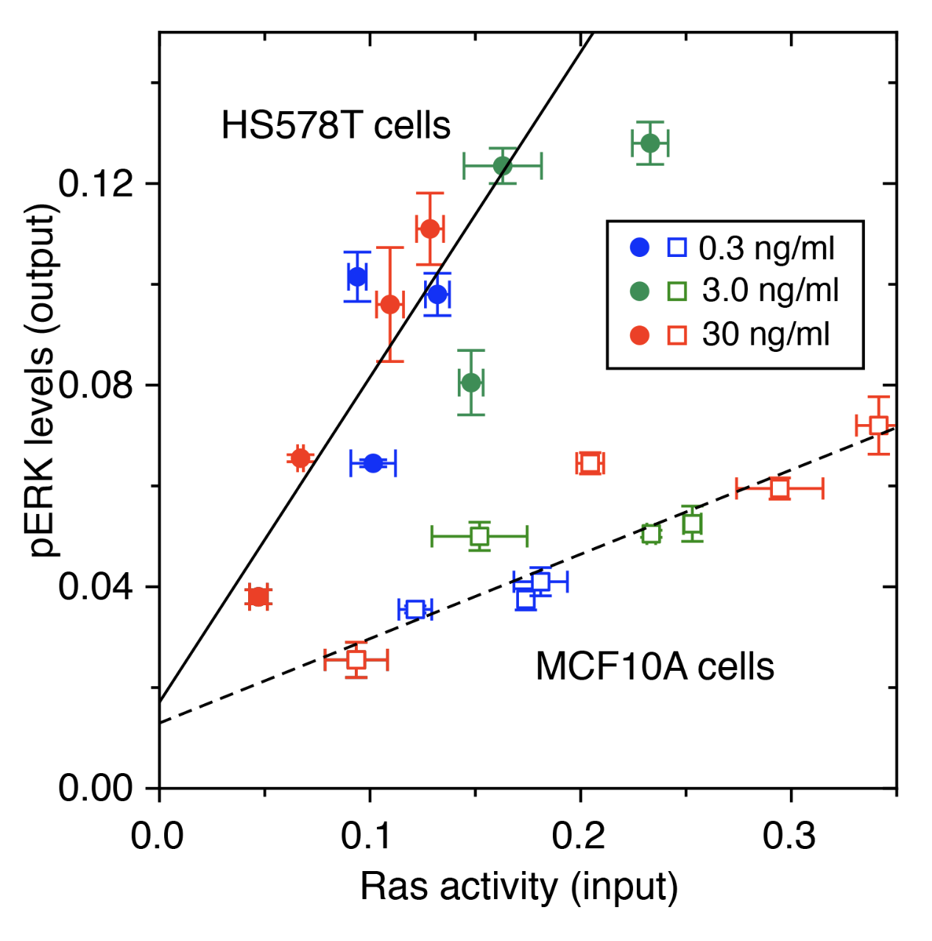
Functional “modules” in the EGFR-ERK pathway display linear input-output relationships

